Slide 1


Git Branching

Slide 2
Git Branching
Branching means you diverge from the main line of development and continue to do work without messing with that main line.
In many VCS tools, this is a somewhat expensive process, often requiring you to create a new copy of your source code directory, which can take a long time for large projects.
The way Git branches is incredibly lightweight, making branching operations nearly instantaneous, and switching back and forth between branches generally just as fast.

Slide 3
...
Git encourages workflows that branch and merge often, even multiple times in a day. Understanding and mastering this feature gives you a powerful and unique tool and can entirely change the way that you develop.

Slide 4
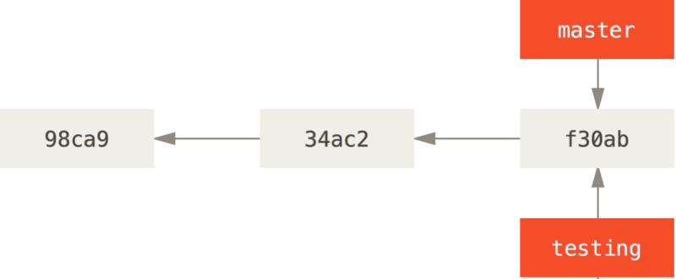
Creating a New Branch
$ git branch <branch-name> helps us to create a new branch.
What does it do?
This creates a new pointer to the same commit you’re currently on.

Slide 5
How does Git know what branch you’re currently on?
It keeps a special pointer called HEAD
In Git, this is a pointer to the local branch you’re currently on
Creating a branch using git branch doesn’t switch you to the newly created branch.
You can easily see this by running a simple git log command that shows you where the branch pointers are pointing. This option is called --decorate.

Slide 6
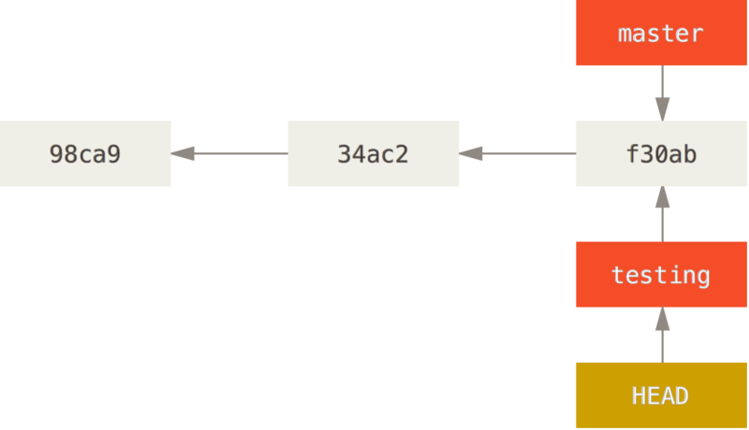
Switching Branches
To switch to an existing branch, you run the git checkout
$ git checkout <branch_name>

Slide 7
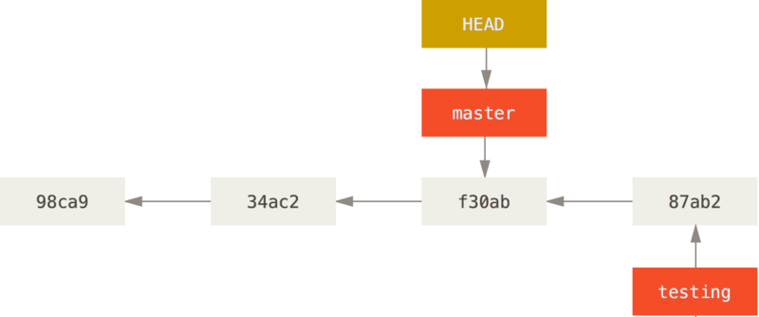
What if you commit on your new branch ?

Slide 8
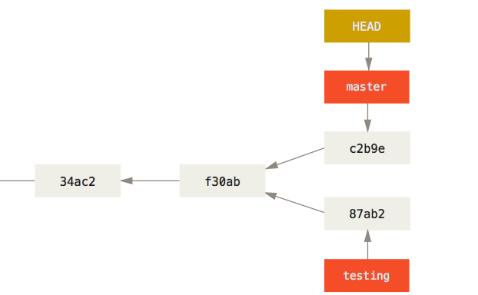
Switch back to master branch and commiting changes results in …

Slide 9
Basic Branching and Merging

Slide 10
Basic Branching and Merging
Let’s go through a simple example of branching and merging with a workflow that you might use in the real world. You’ll follow these steps: - Do some work on a website. - Create a branch for a new user story you’re working on.
- Do some work in that branch. At this stage, you’ll receive a call that another issue is critical and you need a hotfix. You’ll do the following:
- Switch to your production branch. - Create a branch to add the hotfix.
After it’s tested, merge the hotfix branch, and push to production.
Switch back to your original user story and continue working.

Slide 11
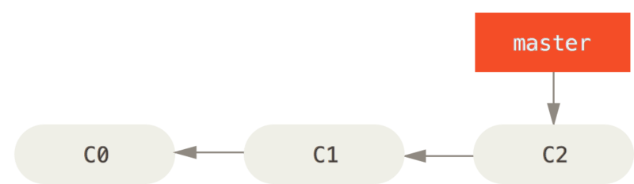
...
First, let’s say you’re working on your project and have a couple of commits already on the master branch.

Slide 12
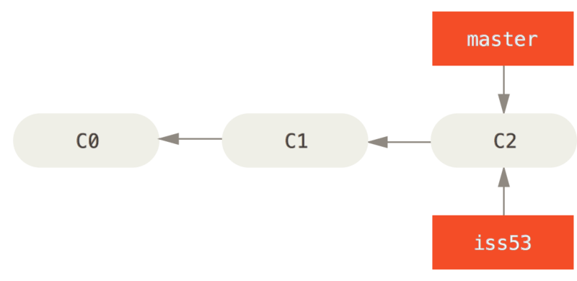
...
To create a new branch and switch to it at the same time, you can run the git checkout command with the -b switch
$ git checkout -b iss53

Slide 13
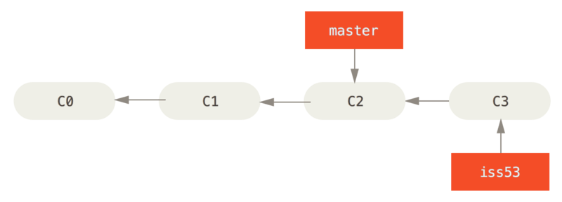
...
You work on your website and do some commits. Doing so moves the iss53 branch forward, because you have it checked out (that is, your HEAD is pointing to it)

Slide 14
Basic Merging
Suppose you’ve decided that your issue #53 work is complete and ready to be merged into your master branch.
All you have to do is check out the branch you wish to merge into and then run the git merge command
$ git checkout master
$ git merge iss53
If you have no further need for the iss53 branch. Delete it by running the following command.
$ git branch -d iss53

Slide 15
Basic Merge Conflicts

Slide 16
Basic Merge Conflicts
If you change the same part of the same file differently in the two branches you’re merging, Git won’t be able to merge them cleanly.
If you want to see which files are unmerged at any point after a merge conflict, you can run git status
Anything that has merge conflicts and hasn’t been resolved is listed as unmerged.

Slide 17
Branch Management

Slide 18
Branch Management
If you run git branch with no arguments, you get a simple listing of your current branches.
* indicates the branch that you currently have checked out (i.e., the branch that HEAD points to).
To see the last commit on each branch, you can run
$ git branch -v

Slide 19
...
To see which branches are already merged into the branch you’re on, you can run
$ git branch --merged
To see which branches are not merged into the branch you’re on, you can run
$ git branch --no-merged

Slide 20
...
Any branch that is not merged cannot be deleted using -d option
If you really do want to delete the branch and lose that work, you can force it with -D

Slide 21
Remote Branches

Slide 22
Pushing your branch to Remote
When you want to share a branch with the world, you need to push it up to a remote to which you have write access.
$ git push origin <Branch_name>

Slide 23
Deleting Remote Branches
If you want to delete your serverfix branch from the server, you run the following
$ git push origin --delete serverfix

Slide 24


